Slide 1

Data Pre-processing using Pandas
4
- Dr. Sifat Momen (SfM1)

Slide 2
Learning goals
After this presentation, you should be able to
Understand the need for data pre-processing
Perform data wrangling using pandas
Perform basic visualization using pandas, and matplotlib

Slide 3
Note
There is an accompanying jupyter notebook for this presentation.
It is best to use both in parallel for better understanding.

Slide 4
Why do we need data pre-processing?
Data has issues
Missing values, noisy data, erroneous data, categorical data, need for feature engineering, irrelevant attributes, … etc.
Most machine learning algorithms can work on numeric data.
In order to clean data, we need to pre-process it to a form that is suitable for machine learning algorithms to work on
Useful Python Supported Libraries:
Pandas – Very useful for wrangling tabular data
Matplotlib, Seaborn – Visualization tools

Slide 5
Import and Loading the Dataset in Pandas
import pandas as pd
housing = pd.read_csv('housing.csv')
dataframe

Slide 6
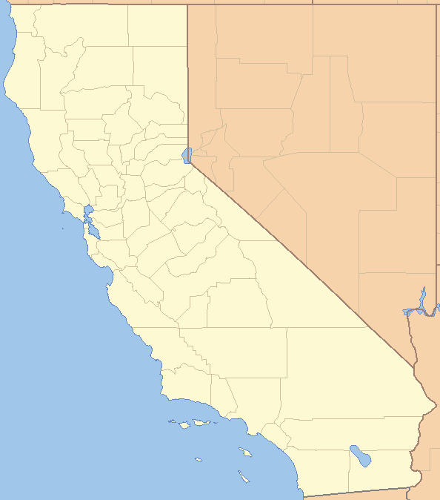
Take a look into the Data Structure – Dataframe.info()
<class 'pandas.core.frame.DataFrame'>
RangeIndex: 20640 entries, 0 to 20639
Data columns (total 10 columns):
# Column Non-Null Count Dtype
--- ------ -------------- -----
0 longitude 20640 non-null float64
1 latitude 20640 non-null float64
2 housing_median_age 20640 non-null int64
3 total_rooms 20640 non-null int64
4 total_bedrooms 20433 non-null float64
5 population 20640 non-null int64
6 households 20640 non-null int64
7 median_income 20640 non-null float64
8 median_house_value 20640 non-null int64
9 ocean_proximity 20640 non-null object
dtypes: float64(4), int64(5), object(1)
memory usage: 1.6+ MB
housing.info()

Slide 7

Take a look into the Data Structure – Dataframe.head()
housing.head()
 | longitude | latitude | housing_median_age | total_rooms | total_bedrooms | population | households | median_income | median_house_value | ocean_proximity
0 | -122.23 | 37.88 | 41 | 880 | 129.0 | 322 | 126 | 8.3252 | 452600 | NEAR BAY
1 | -122.22 | 37.86 | 21 | 7099 | 1106.0 | 2401 | 1138 | 8.3014 | 358500 | NEAR BAY
2 | -122.24 | 37.85 | 52 | 1467 | 190.0 | 496 | 177 | 7.2574 | 352100 | NEAR BAY
3 | -122.25 | 37.85 | 52 | 1274 | 235.0 | 558 | 219 | 5.6431 | 341300 | NEAR BAY
4 | -122.25 | 37.85 | 52 | 1627 | 280.0 | 565 | 259 | 3.8462 | 342200 | NEAR BAY

Slide 8
Shape of the Dataframe – DataFrame.shape
# print the shape of the dataframe
housing.shape
(20640, 10)
# print the number of rows and columns
print("Number of Rows: ", housing.shape[0])
print("Number of Columns: ", housing.shape[1])
Number of Rows: 20640
Number of Columns: 10

Slide 9
List the Columns in the Dataset – DataFrame.columns
housing.columns
Index(['longitude', 'latitude', 'housing_median_age', 'total_rooms',
'total_bedrooms', 'population', 'households', 'median_income',
'median_house_value', 'ocean_proximity'],
dtype='object')

Slide 10
To see the data types of columns
Data Type in Python | Data Type in Pandas
Float | Float64
Int | Int64
String | object
housing.dtypes
longitude float64
latitude float64
housing_median_age int64
total_rooms int64
total_bedrooms float64
population int64
households int64
median_income float64
median_house_value int64
ocean_proximity object
dtype: object
housing['median_income'].dtype
dtype('float64')

Slide 11
Number of unique values in a particular column as well the total number of instances for each unique value – DataFrame[‘column-name’].value_counts()
housing['ocean_proximity'].value_counts()
<1H OCEAN 9136
INLAND 6551
NEAR OCEAN 2658
NEAR BAY 2290
ISLAND 5
Name: ocean_proximity, dtype: int64

Slide 12
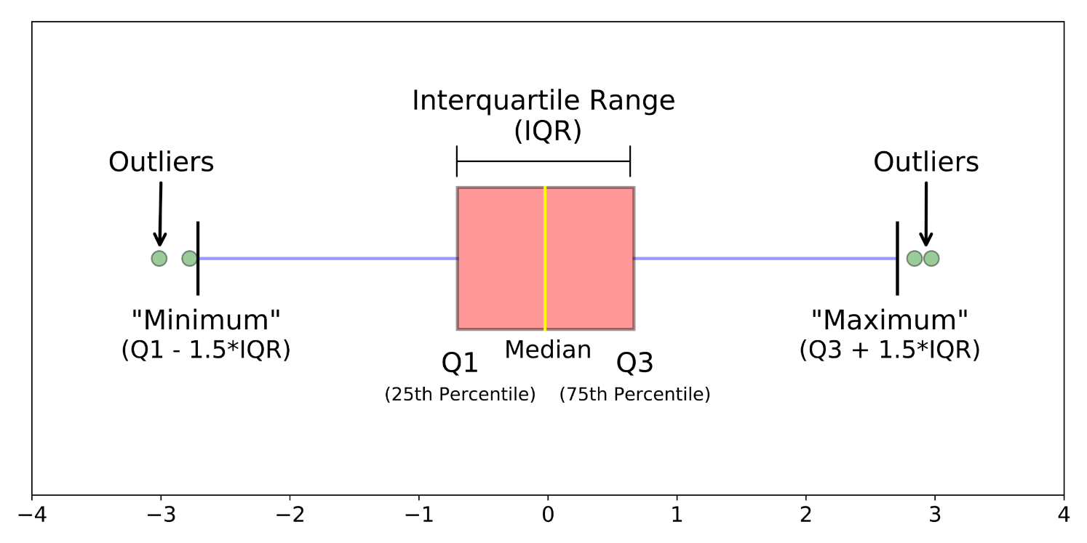
Generating Descriptive Statistics Summary for a given dataframe – DataFrame.describe()
This will work only for numerical columns – Descriptive summary includes:
Count – Total Number of Elements
Mean – Average (arithmetic mean)
Std – Standard Deviation
Min – Smallest Value
25% - Lower Quartile (Q1)
50% - Median (Q2)
75% - Upper Quartile (Q3)
Max – Maximum Value

Slide 13
Generating Descriptive Statistics Summary for a given dataframe – DataFrame.describe()
 | longitude | latitude | housing_median_age | total_rooms | total_bedrooms | population | households | median_income | median_house_value
count | 20640.000000 | 20640.000000 | 20640.000000 | 20640.000000 | 20433.000000 | 20640.000000 | 20640.000000 | 20640.000000 | 20640.000000
mean | -119.569704 | 35.631861 | 28.639486 | 2635.763081 | 537.870553 | 1425.476744 | 499.539680 | 3.870671 | 206855.816909
std | 2.003532 | 2.135952 | 12.585558 | 2181.615252 | 421.385070 | 1132.462122 | 382.329753 | 1.899822 | 115395.615874
min | -124.350000 | 32.540000 | 1.000000 | 2.000000 | 1.000000 | 3.000000 | 1.000000 | 0.499900 | 14999.000000
25% | -121.800000 | 33.930000 | 18.000000 | 1447.750000 | 296.000000 | 787.000000 | 280.000000 | 2.563400 | 119600.000000
50% | -118.490000 | 34.260000 | 29.000000 | 2127.000000 | 435.000000 | 1166.000000 | 409.000000 | 3.534800 | 179700.000000
75% | -118.010000 | 37.710000 | 37.000000 | 3148.000000 | 647.000000 | 1725.000000 | 605.000000 | 4.743250 | 264725.000000
max | -114.310000 | 41.950000 | 52.000000 | 39320.000000 | 6445.000000 | 35682.000000 | 6082.000000 | 15.000100 | 500001.000000
housing.describe()

Slide 14
Code to save figures as high resolution PNGs
import os
from pathlib import Path
IMAGES_PATH = Path() / "images" / "Data Preprocessing"
IMAGES_PATH.mkdir(parents=True, exist_ok=True)
def save_fig(fig_id, tight_layout=True, fig_extension="png", resolution=300):
path = IMAGES_PATH / f"{fig_id}.{fig_extension}"
if tight_layout:
plt.tight_layout()
plt.savefig(path, format=fig_extension, dpi=resolution)

Slide 15
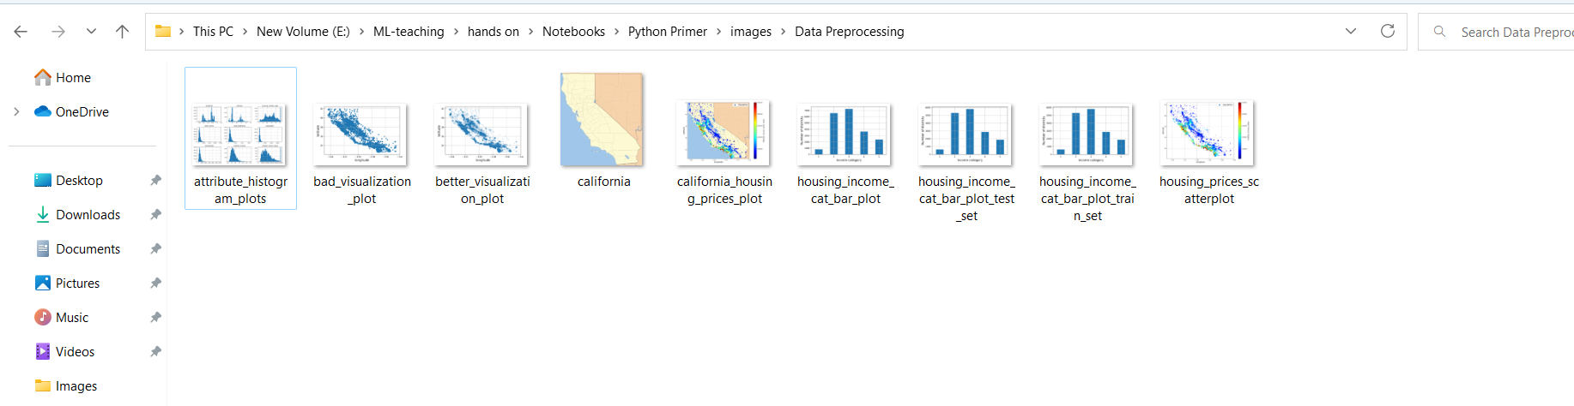
Pictures Saved in the Directory

Slide 16
Saving a histogram plot
import matplotlib.pyplot as plt
# extra code – the next 5 lines define the default font sizes
plt.rc('font', size=14)
plt.rc('axes', labelsize=14, titlesize=14)
plt.rc('legend', fontsize=14)
plt.rc('xtick', labelsize=10)
plt.rc('ytick', labelsize=10)
housing.hist(bins=50, figsize=(12, 8))
save_fig("attribute_histogram_plots") # extra code
plt.show()

Slide 17
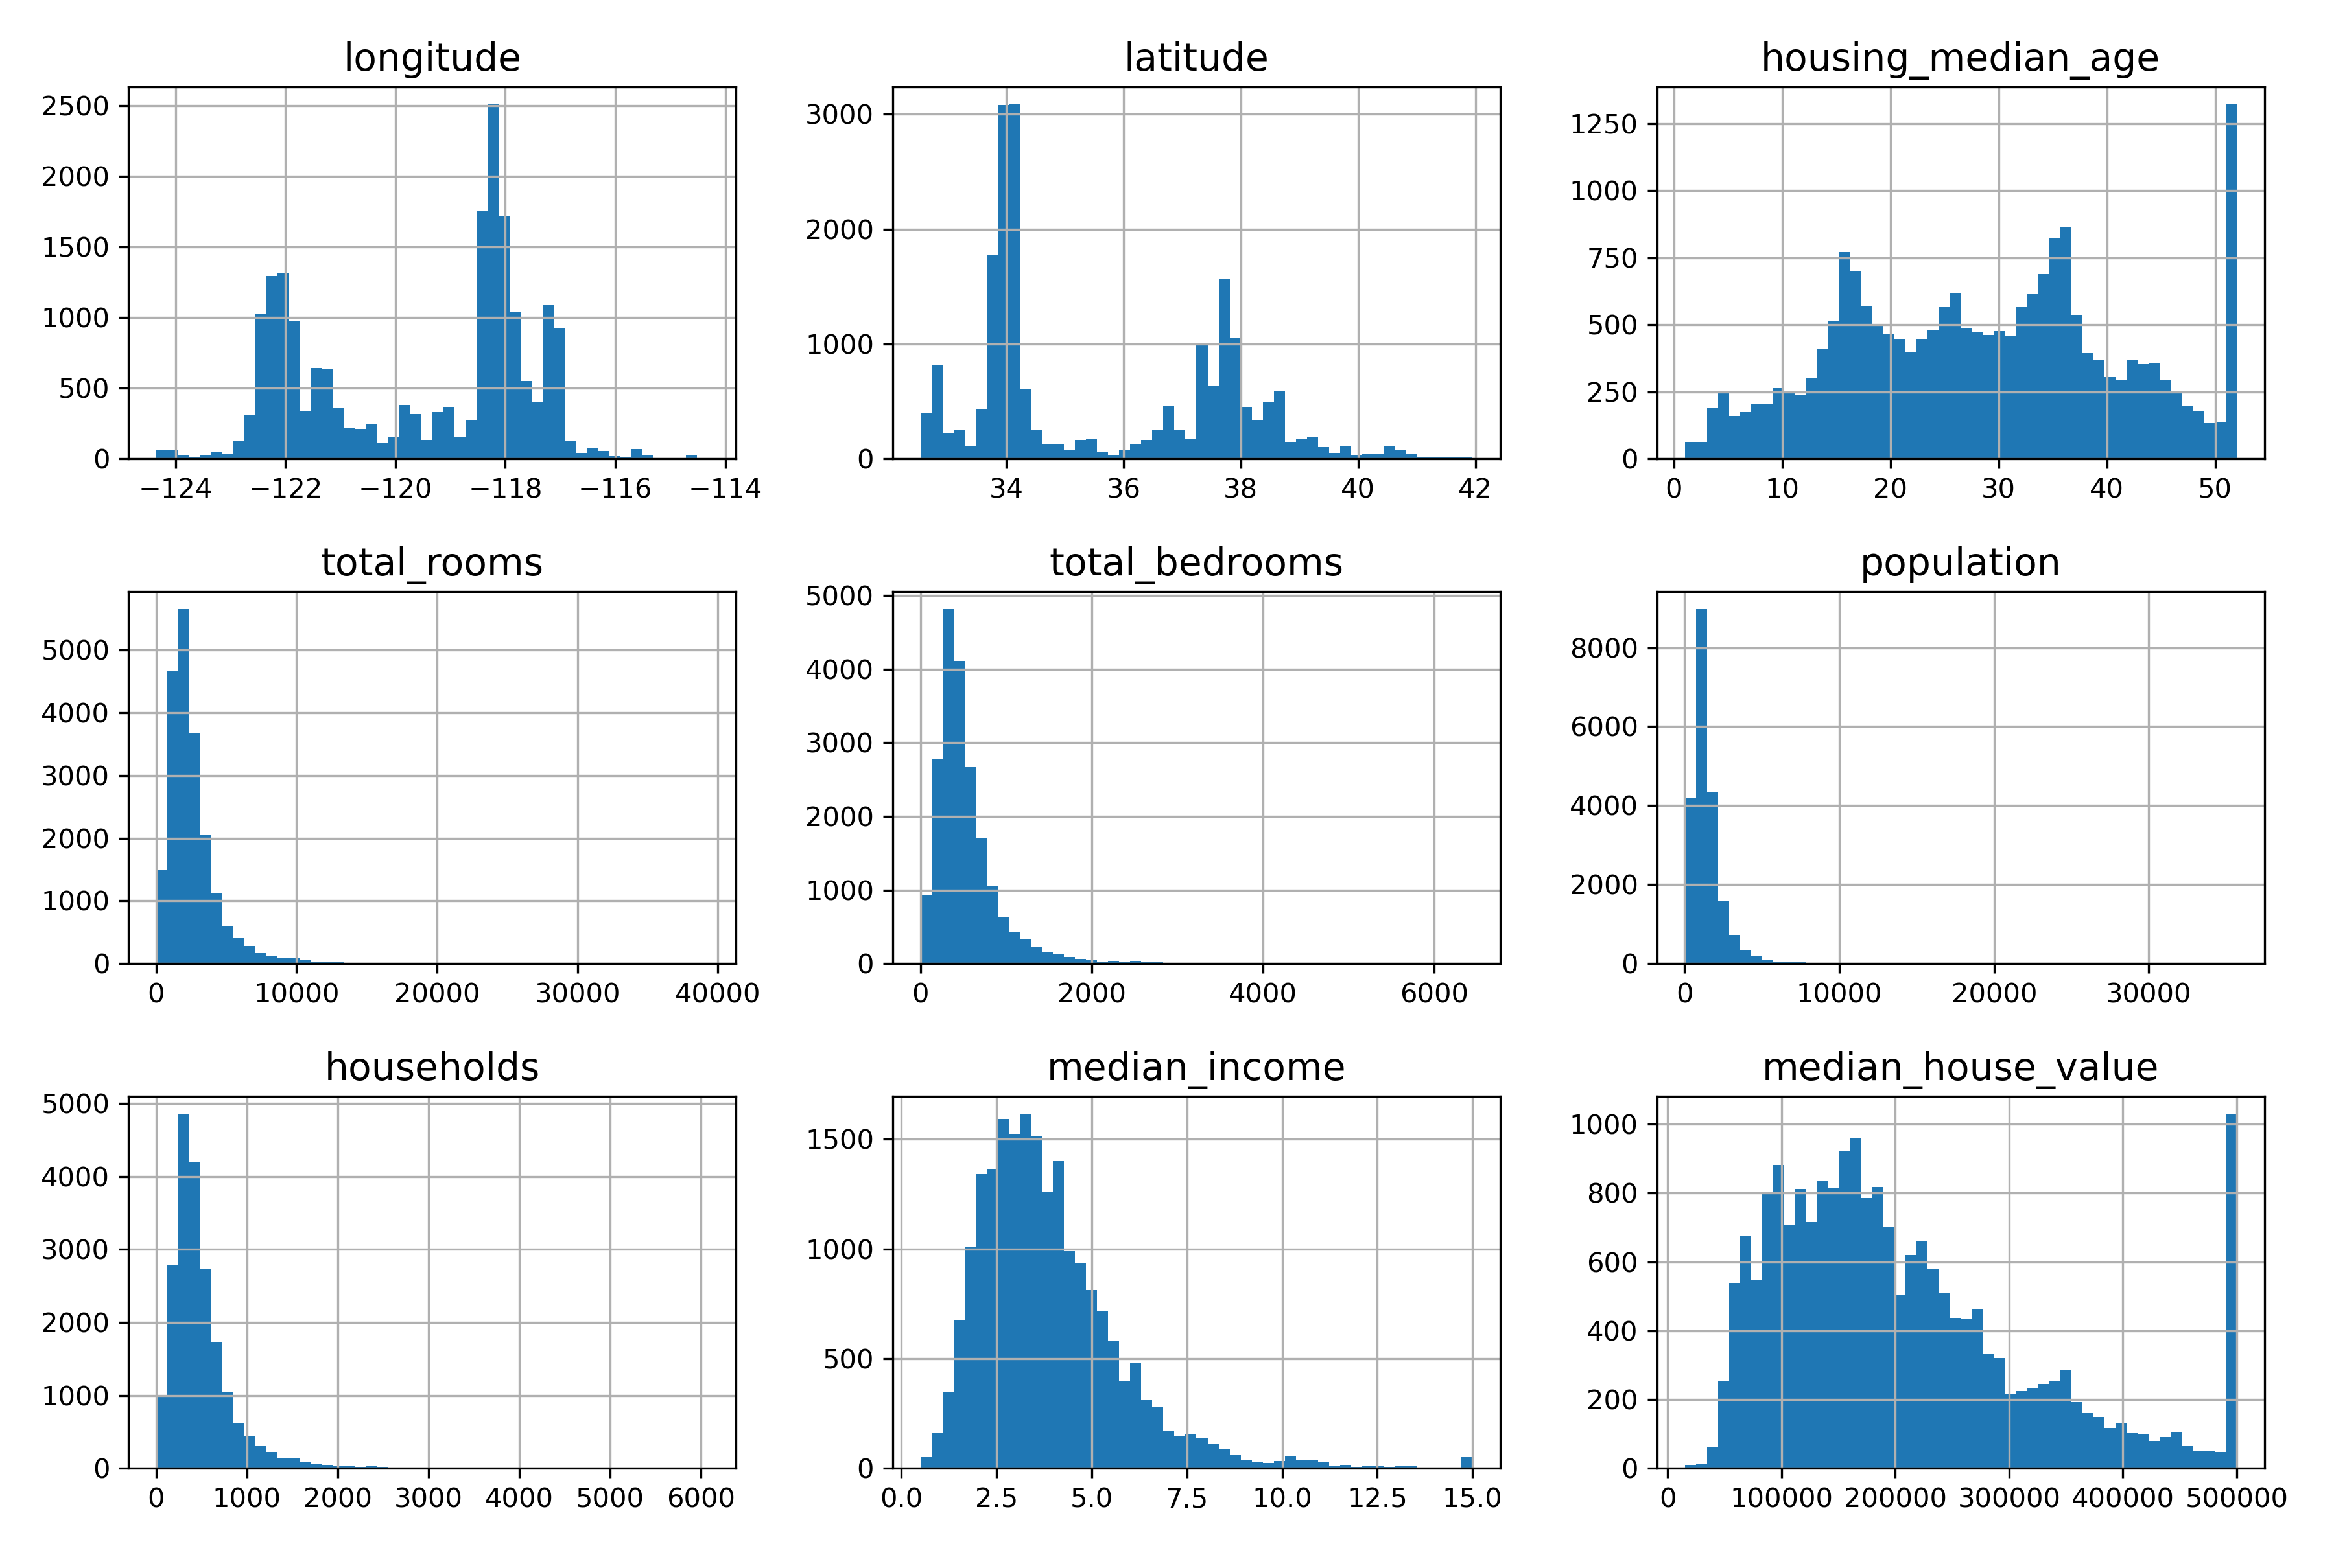
Histogram Plots

Slide 18
Splitting the Dataset into train and test set
Recall that a model needs to be created from a train set.
A test set should only be used to evaluate how a model is performing on an unseen dataset.
So, we need to split the dataset that is available to us into separate train and test sets.
Also, we want to randomize the selection of records into train and test set

Slide 19
Splitting the Dataset into train and test set
import numpy as np
def shuffle_and_split_data(data, test_ratio):
shuffled_indices = np.random.permutation(len(data))
test_set_size = int(len(data) * test_ratio)
test_indices = shuffled_indices[:test_set_size]
train_indices = shuffled_indices[test_set_size:]
return data.iloc[train_indices], data.iloc[test_indices]
train_set, test_set = shuffle_and_split_data(housing, 0.2)
len(train_set)
16512
len(test_set)
4128
Just to Verify
0.2 * housing.shape[0]
4128.0

Slide 20
Splitting the Dataset into train and test set
import numpy as np
def shuffle_and_split_data(data, test_ratio):
shuffled_indices = np.random.permutation(len(data))
test_set_size = int(len(data) * test_ratio)
test_indices = shuffled_indices[:test_set_size]
train_indices = shuffled_indices[test_set_size:]
return data.iloc[train_indices], data.iloc[test_indices]
train_set, test_set = shuffle_and_split_data(housing, 0.2)
len(train_set)
16512
len(test_set)
4128
Just to Verify
0.2 * housing.shape[0]
4128.0
Can you find out any issue with this implementation?

Slide 21
Using scikit learn to split the dataset
from sklearn.model_selection import train_test_split
train_set, test_set = train_test_split(housing, test_size=0.2, random_state=42)
len(test_set)
4128

Slide 22
Stratified Sampling
Let us say that median-income has been identified as a very important feature
Hence we want to ensure that the when the dataset has been split, the right number of representation sample has is present in both train and test set
housing["income_cat"] = pd.cut(housing["median_income"],
bins=[0., 1.5, 3.0, 4.5, 6., np.inf],
labels=[1, 2, 3, 4, 5])

Slide 23
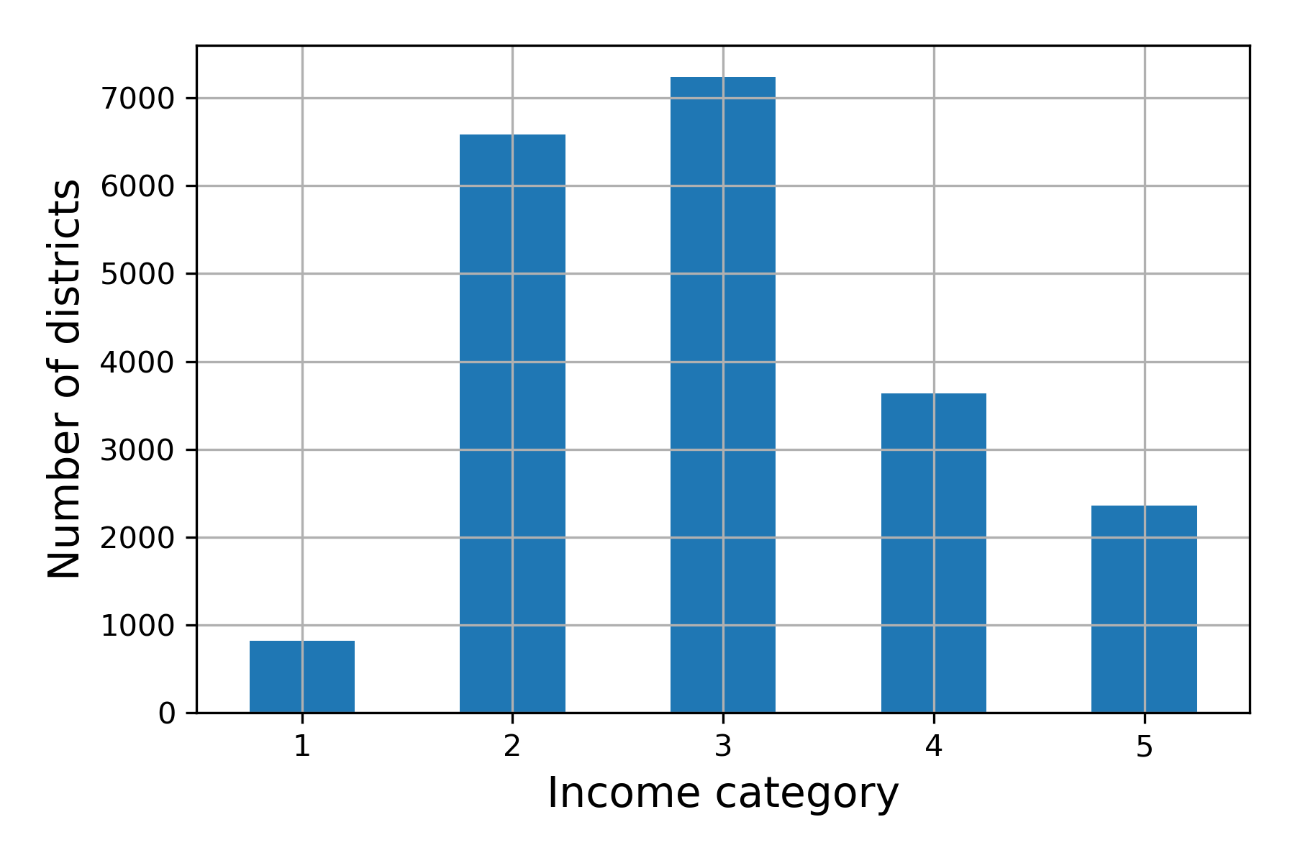
Stratified Sampling
housing["income_cat"] = pd.cut(housing["median_income"],
bins=[0., 1.5, 3.0, 4.5, 6., np.inf],
labels=[1, 2, 3, 4, 5])
housing["income_cat"].value_counts().sort_index().plot.bar(rot=0, grid=True)
plt.xlabel("Income category")
plt.ylabel("Number of districts")
save_fig("housing_income_cat_bar_plot") # extra code
plt.show()

Slide 24
Stratified Sampling
housing['income_cat'].value_counts()
3 7236
2 6581
4 3639
5 2362
1 822
Name: income_cat, dtype: int64

Slide 25
Stratified Sampling
Apply the setting in both train and test set
train_set["income_cat"] = pd.cut(train_set["median_income"],
bins=[0., 1.5, 3.0, 4.5, 6., np.inf],
labels=[1, 2, 3, 4, 5])
train_set["income_cat"].value_counts().sort_index().plot.bar(rot=0, grid=True)
plt.xlabel("Income category")
plt.ylabel("Number of districts")
save_fig("housing_income_cat_bar_plot_train_set") # extra code
plt.show()
test_set["income_cat"] = pd.cut(test_set["median_income"],
bins=[0., 1.5, 3.0, 4.5, 6., np.inf],
labels=[1, 2, 3, 4, 5])
test_set["income_cat"].value_counts().sort_index().plot.bar(rot=0, grid=True)
plt.xlabel("Income category")
plt.ylabel("Number of districts")
save_fig("housing_income_cat_bar_plot_test_set") # extra code
plt.show()

Slide 26

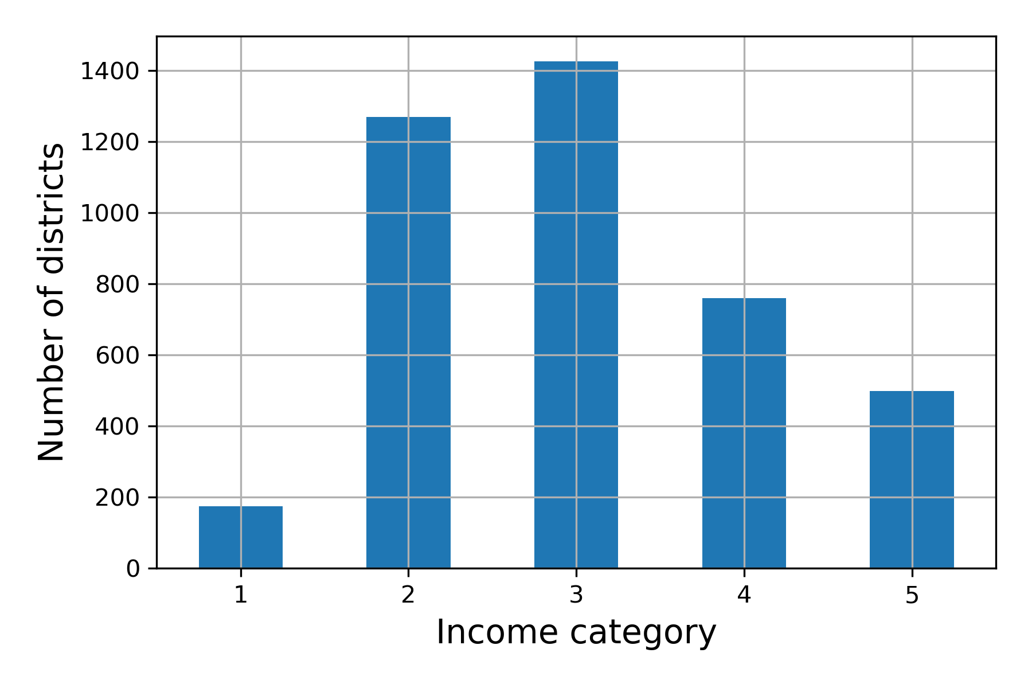
Stratified Sampling
Distribution in the train set
Distribution in the test set

Slide 27
Stratified Sampling
Category | Proportion in original dataset | Proportion in train set | Proportion in test set
1 | 0.039826 | 0.039184 | 0.042393
2 | 0.318847 | 0.321705 | 0.307413
3 | 0.350581 | 0.351926 | 0.345203
4 | 0.176308 | 0.174358 | 0.184109
5 | 0.114438 | 0.112827 | 0.120882

Slide 28
Stratified Sampling
strat_train_set, strat_test_set = train_test_split(
housing, test_size=0.2, random_state=42, stratify = housing['income_cat'])
Category | Proportion in original dataset | Proportion in train set | Proportion in test set
1 | 0.039826 | 0.039789 | 0.039971
2 | 0.318847 | 0.318859 | 0.318798
3 | 0.350581 | 0.350594 | 0.350533
4 | 0.176308 | 0.176296 | 0.176357
5 | 0.114438 | 0.114462 | 0.114341

Slide 29
Before and After Stratified Sampling
Category | Proportion in original dataset | Proportion in train set | Proportion in test set
1 | 0.039826 | 0.039184 | 0.042393
2 | 0.318847 | 0.321705 | 0.307413
3 | 0.350581 | 0.351926 | 0.345203
4 | 0.176308 | 0.174358 | 0.184109
5 | 0.114438 | 0.112827 | 0.120882
Before stratified sampling
Category | Proportion in original dataset | Proportion in train set | Proportion in test set
1 | 0.039826 | 0.039789 | 0.039971
2 | 0.318847 | 0.318859 | 0.318798
3 | 0.350581 | 0.350594 | 0.350533
4 | 0.176308 | 0.176296 | 0.176357
5 | 0.114438 | 0.114462 | 0.114341
After stratified sampling

Slide 30
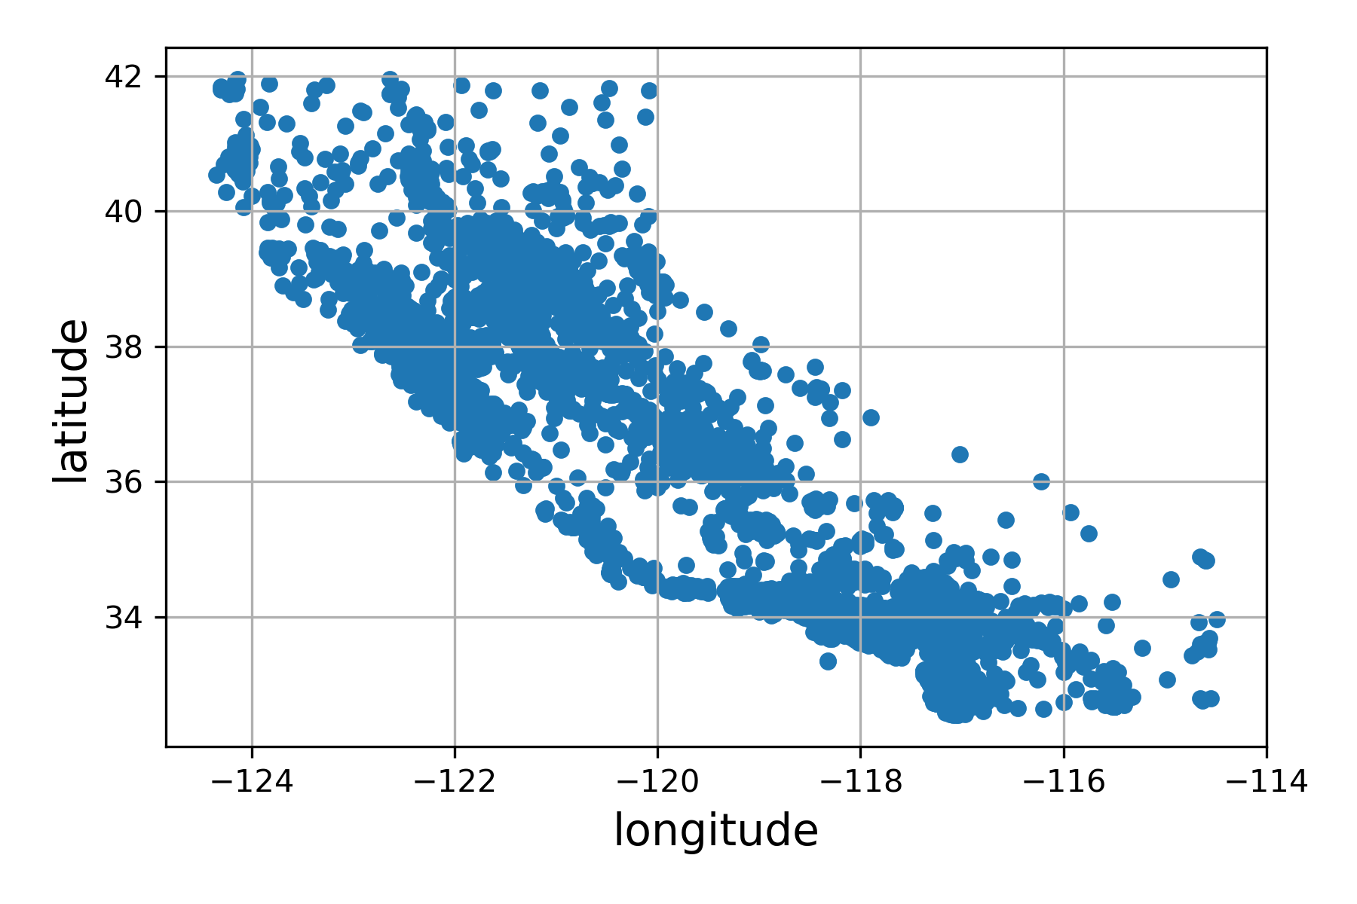
Visualizing the stratified train set
housing = strat_train_set.copy()
housing.plot(kind="scatter", x="longitude", y="latitude", grid=True)
save_fig("bad_visualization_plot") plt.show()

Slide 31
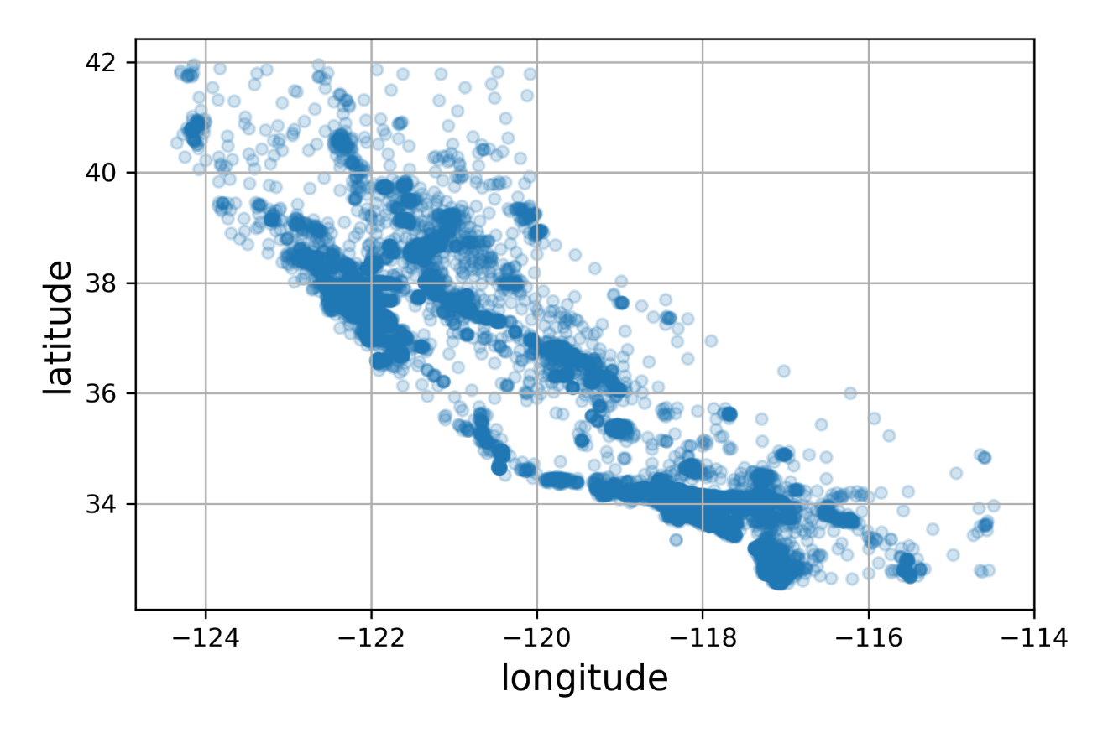
A better visualization
housing.plot(kind="scatter", x="longitude", y="latitude", grid=True, alpha=0.2)
save_fig("better_visualization_plot") # extra code
plt.show()

Slide 32
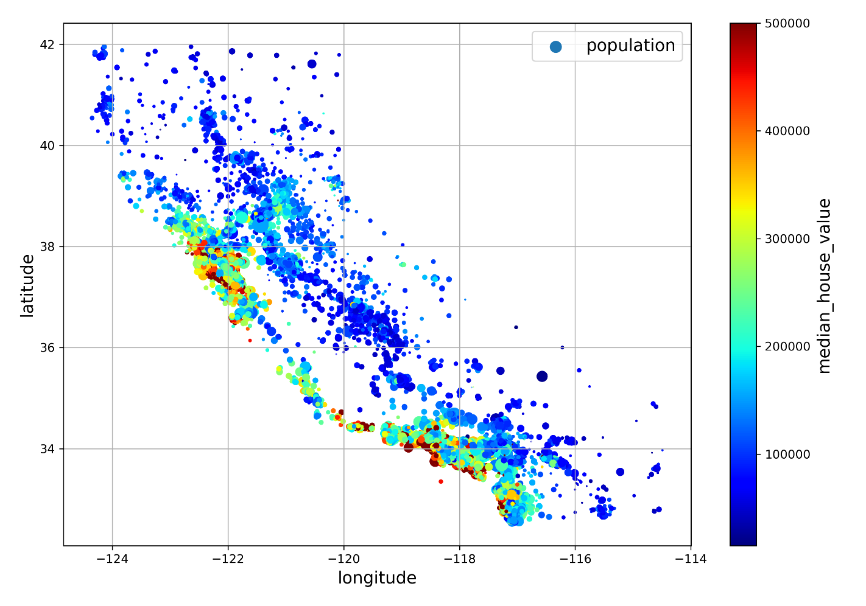
A lot better visualization
housing.plot(kind="scatter", x="longitude", y="latitude", grid=True,
s=housing["population"] / 100, label="population",
c="median_house_value", cmap="jet", colorbar=True,
legend=True, sharex=False, figsize=(10, 7))
save_fig("housing_prices_scatterplot") # extra code
plt.show()

Slide 33
Even Better Visualization
filename = "california.png"
housing_renamed = housing.rename(columns={
"latitude": "Latitude", "longitude": "Longitude",
"population": "Population",
"median_house_value": "Median house value (ᴜsᴅ)"})
housing_renamed.plot(
kind="scatter", x="Longitude", y="Latitude",
s=housing_renamed["Population"] / 100, label="Population",
c="Median house value (ᴜsᴅ)", cmap="jet", colorbar=True,
legend=True, sharex=False, figsize=(10, 7))
california_img = plt.imread(IMAGES_PATH / filename)
axis = -124.55, -113.95, 32.45, 42.05
plt.axis(axis)
plt.imshow(california_img, extent=axis)
save_fig("california_housing_prices_plot")
plt.show()

Slide 34
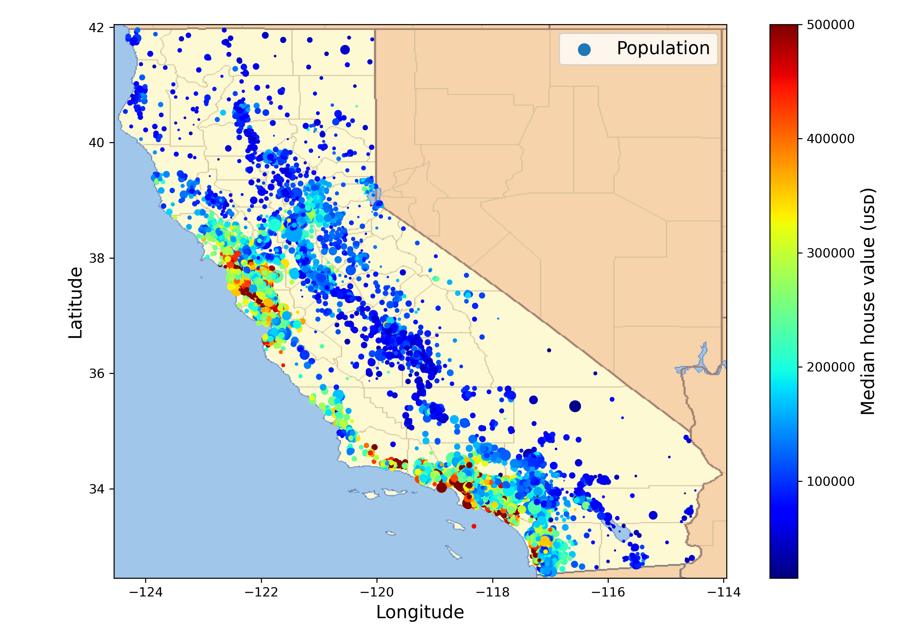

Slide 35
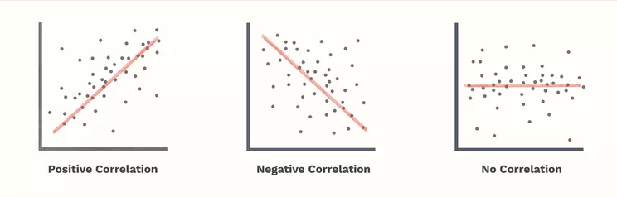
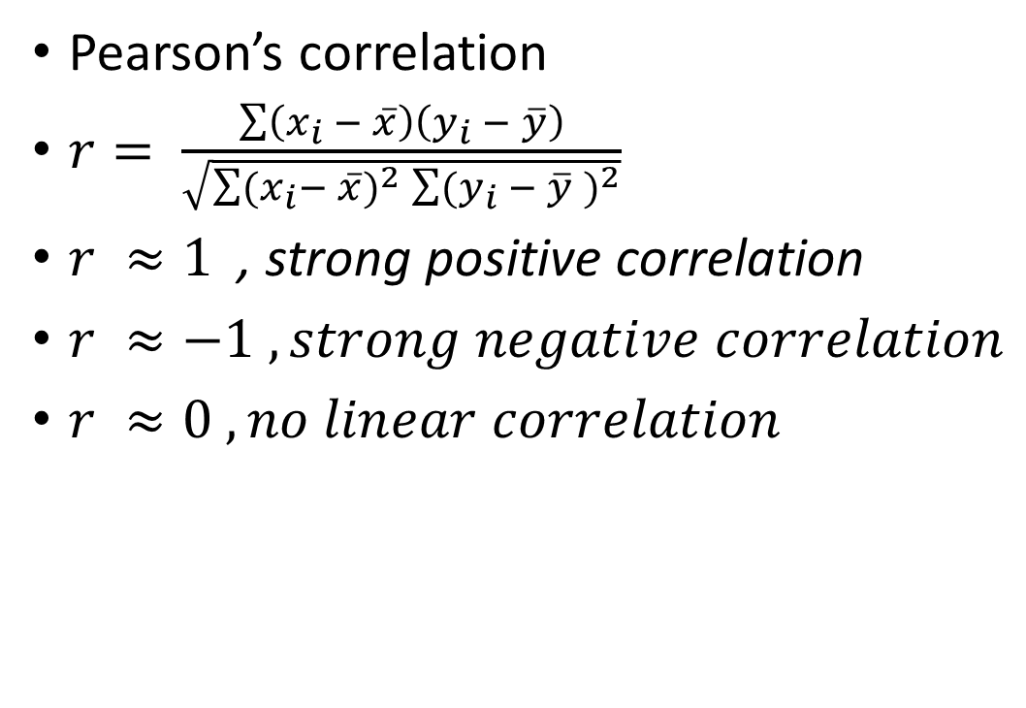
Linear Correlation
Pearson’s correlation
$r= \frac{\sum{\left(x_{i} − \overline{x}\right)\left(y_{i} − \overline{y}\right)}}{\sqrt{\sum{(x_{i}}− \overline{x})^{2}\sum{(y_{i} − \overline{y} )^{2}}}}$
$r ≈1$ , strong positive correlation
$r ≈−1 , strong negative correlation$
$r ≈0 , no linear correlation$

Slide 36
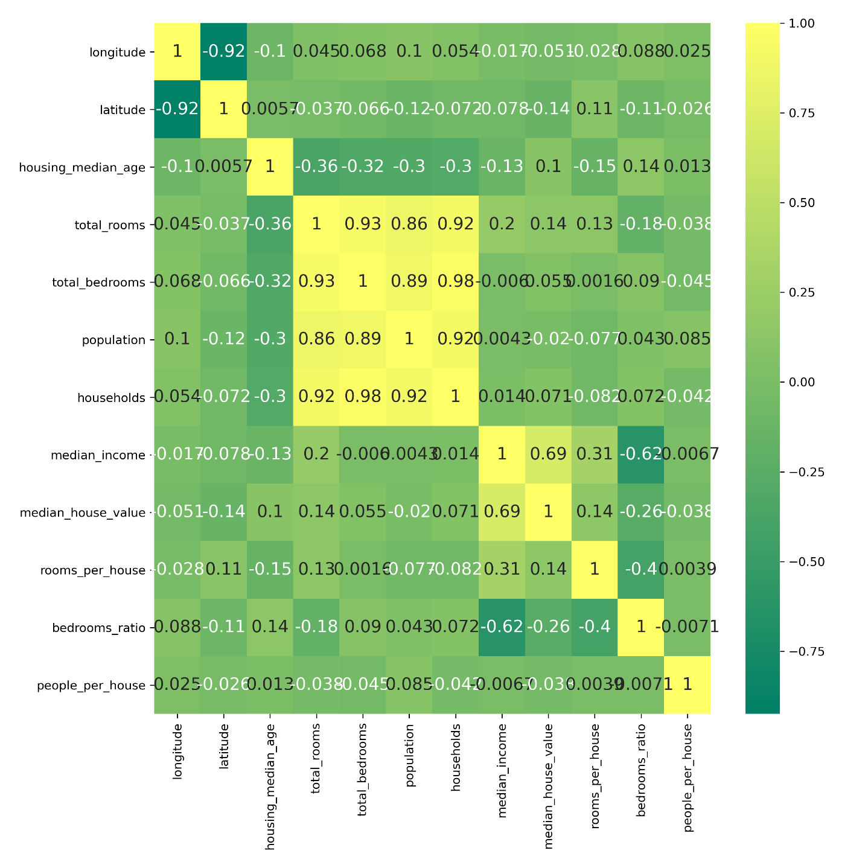
Correlation
import seaborn as sns
plt.figure(figsize = (10,10))
sns.heatmap(corr_matrix, annot = True, cmap = 'summer')
save_fig('correlation')
plt.show()

Slide 37
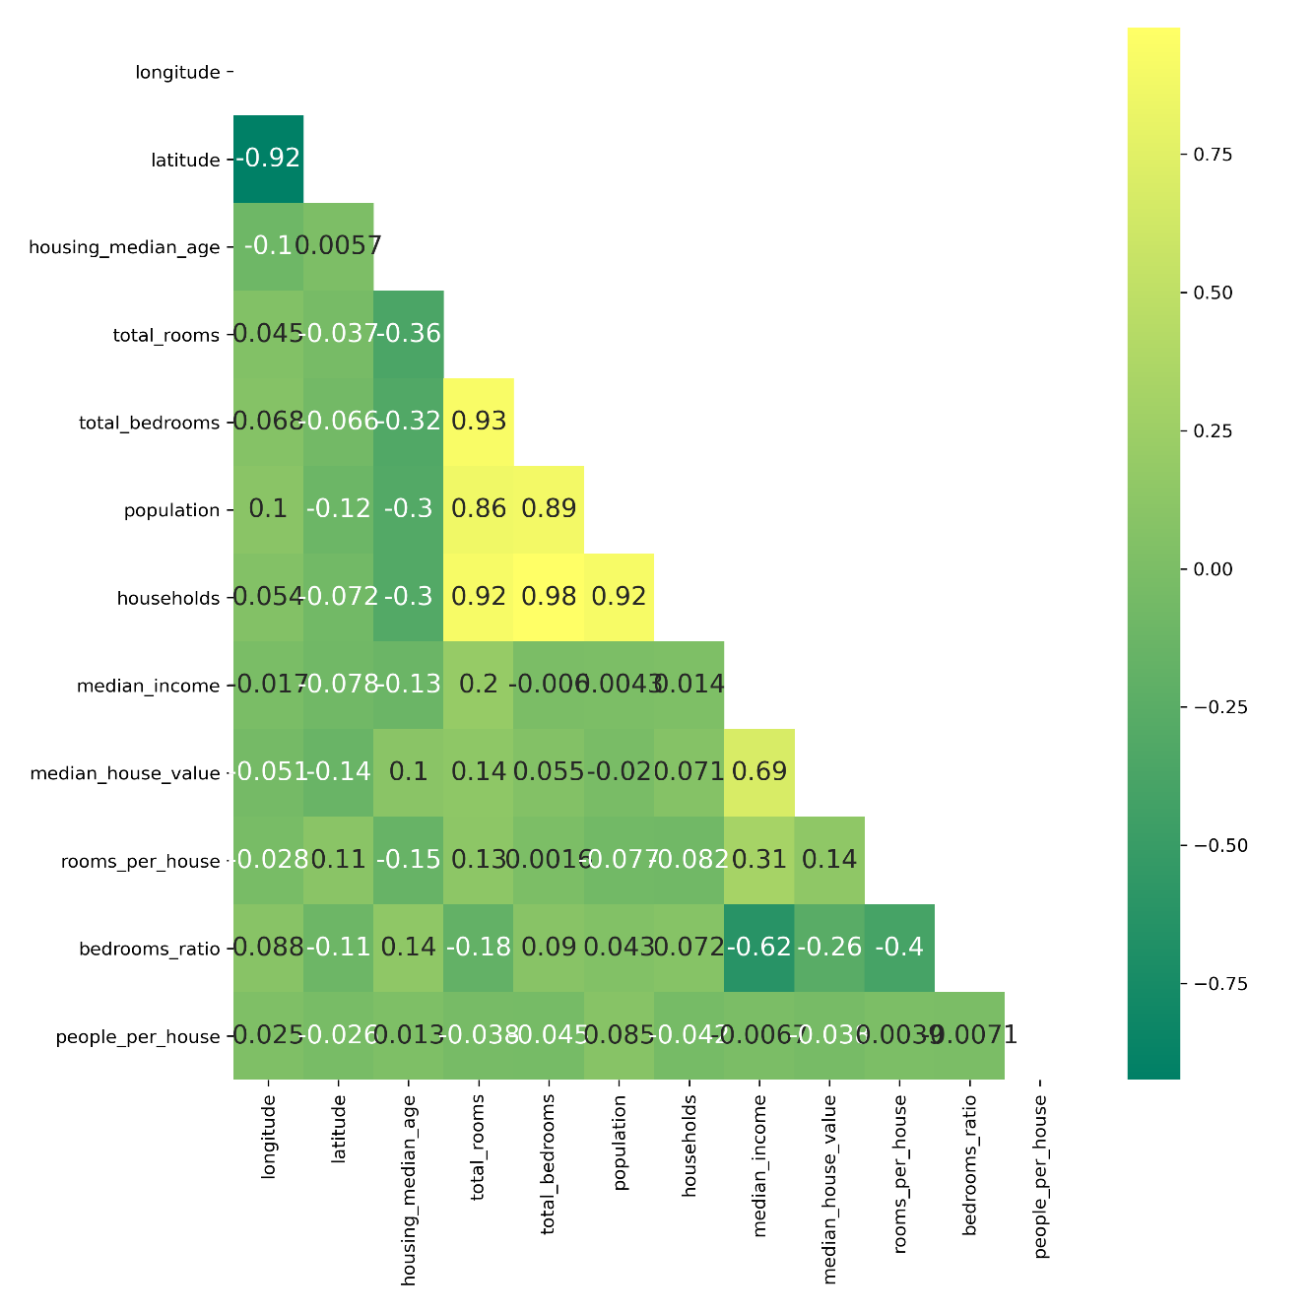
Correlation – Showing the Lower triangle
import seaborn as sns
mask = np.triu(corr_matrix)
#mask = np.tril(corr_matrix)
plt.figure(figsize = (10,10))
sns.heatmap(corr_matrix, annot = True, cmap = 'summer', mask = mask)
save_fig('correlation-lower tiangle')
plt.show()

Slide 38
Printing corr_martix
 | longitude | latitude | housing_median_age | total_rooms | total_bedrooms | population | households | median_income | median_house_value
longitude | 1.000000 | -0.924213 | -0.102937 | 0.044558 | 0.068210 | 0.104236 | 0.054261 | -0.016542 | -0.050859
latitude | -0.924213 | 1.000000 | 0.005692 | -0.036753 | -0.066391 | -0.115677 | -0.071604 | -0.078137 | -0.139584
housing_median_age | -0.102937 | 0.005692 | 1.000000 | -0.361710 | -0.317978 | -0.301906 | -0.300075 | -0.127043 | 0.102175
total_rooms | 0.044558 | -0.036753 | -0.361710 | 1.000000 | 0.930076 | 0.863967 | 0.916143 | 0.197720 | 0.137455
total_bedrooms | 0.068210 | -0.066391 | -0.317978 | 0.930076 | 1.000000 | 0.886200 | 0.978822 | -0.006038 | 0.054635
population | 0.104236 | -0.115677 | -0.301906 | 0.863967 | 0.886200 | 1.000000 | 0.916237 | 0.004282 | -0.020153
households | 0.054261 | -0.071604 | -0.300075 | 0.916143 | 0.978822 | 0.916237 | 1.000000 | 0.013637 | 0.071426
median_income | -0.016542 | -0.078137 | -0.127043 | 0.197720 | -0.006038 | 0.004282 | 0.013637 | 1.000000 | 0.688380
median_house_value | -0.050859 | -0.139584 | 0.102175 | 0.137455 | 0.054635 | -0.020153 | 0.071426 | 0.688380 | 1.000000

Slide 39
To display correlation of a particular variable with other variables
corr_matrix["median_house_value"]
longitude -0.050859
latitude -0.139584
housing_median_age 0.102175
total_rooms 0.137455
total_bedrooms 0.054635
population -0.020153
households 0.071426
median_income 0.688380
median_house_value 1.000000
Name: median_house_value, dtype: float64

Slide 40
Feature Engineering
Let’s create some salient features
Rooms per house
Bedrooms ratio
People per house
housing["rooms_per_house"] = housing["total_rooms"] / housing["households"]
housing["bedrooms_ratio"] = housing["total_bedrooms"] / housing["total_rooms"]
housing["people_per_house"] = housing["population"] / housing["households"]
housing.head(10)

Slide 41
 | longitude | latitude | housing_median_age | total_rooms | total_bedrooms | population | households | median_income | median_house_value | ocean_proximity | income_cat | rooms_per_house | bedrooms_ratio | people_per_house
13096 | -122.42 | 37.80 | 52 | 3321 | 1115.0 | 1576 | 1034 | 2.0987 | 458300 | NEAR BAY | 2 | 3.211799 | 0.335742 | 1.524178
14973 | -118.38 | 34.14 | 40 | 1965 | 354.0 | 666 | 357 | 6.0876 | 483800 | <1H OCEAN | 5 | 5.504202 | 0.180153 | 1.865546
3785 | -121.98 | 38.36 | 33 | 1083 | 217.0 | 562 | 203 | 2.4330 | 101700 | INLAND | 2 | 5.334975 | 0.200369 | 2.768473
14689 | -117.11 | 33.75 | 17 | 4174 | 851.0 | 1845 | 780 | 2.2618 | 96100 | INLAND | 2 | 5.351282 | 0.203881 | 2.365385
20507 | -118.15 | 33.77 | 36 | 4366 | 1211.0 | 1912 | 1172 | 3.5292 | 361800 | NEAR OCEAN | 3 | 3.725256 | 0.277371 | 1.631399
1286 | -121.31 | 37.96 | 52 | 1829 | 301.0 | 694 | 319 | 3.3466 | 92600 | INLAND | 3 | 5.733542 | 0.164571 | 2.175549
18078 | -118.36 | 33.85 | 34 | 1086 | 197.0 | 509 | 158 | 6.1133 | 349300 | <1H OCEAN | 5 | 6.873418 | 0.181400 | 3.221519
4396 | -122.13 | 37.41 | 36 | 4787 | 900.0 | 2039 | 890 | 5.4063 | 440900 | NEAR BAY | 4 | 5.378652 | 0.188009 | 2.291011
18031 | -118.44 | 34.31 | 22 | 3182 | 822.0 | 2661 | 746 | 2.7472 | 160100 | <1H OCEAN | 2 | 4.265416 | 0.258328 | 3.567024
6753 | -118.13 | 34.06 | 17 | 1714 | 572.0 | 1590 | 568 | 1.1875 | 183900 | <1H OCEAN | 1 | 3.017606 | 0.333722 | 2.799296

Slide 42
Which features are more correlated to median_house_value?

Slide 43
Which features are more correlated to median_house_value?
median_house_value 1.000000
median_income 0.688380
rooms_per_house 0.143663
total_rooms 0.137455
housing_median_age 0.102175
households 0.071426
total_bedrooms 0.054635
population -0.020153
people_per_house -0.038224
longitude -0.050859
latitude -0.139584
bedrooms_ratio -0.256397
Name: median_house_value, dtype: float64
corr_matrix = housing.corr()
corr_matrix["median_house_value"].sort_values(ascending=False)
Some are positively and some are negatively correlated.
We need to therefore determine absolute correlation

Slide 44
Which features are more correlated to median_house_value?
absolute_corr_matrix = abs(corr_matrix)
absolute_corr_matrix["median_house_value"].sort_values(ascending=False)
median_house_value 1.000000
median_income 0.688380
bedrooms_ratio 0.256397
rooms_per_house 0.143663
latitude 0.139584
total_rooms 0.137455
housing_median_age 0.102175
households 0.071426
total_bedrooms 0.054635
longitude 0.050859
people_per_house 0.038224
population 0.020153
Name: median_house_value, dtype: float64

Slide 45
Data Cleaning – NULL Values
longitude 0
latitude 0
housing_median_age 0
total_rooms 0
total_bedrooms 168
population 0
households 0
median_income 0
median_house_value 0
ocean_proximity 0
income_cat 0
rooms_per_house 0
bedrooms_ratio 168
people_per_house 0
dtype: int64
housing.isnull().sum()
print(housing.isnull().sum().sum())
336

Slide 46
How to Deal with NULL Entries?
# total_bedrooms and bedroom_ratio has some missing values
# Fixing Options
# 1. Get rid of the corresponding rows
# 2. Get rid of the whole attribute
# 3. Set the values to some values (e.g. zero, mean, median etc...)
# OPTION 1: housing.dropna(subset = ["total_bedrooms","bedrooms_ratio" ], inplace = True)
# OPTION 2: housing.drop( ["total_bedrooms","bedrooms_ratio" ], axis = 1, inplace = True)
# OPTION 3: housing[["total_bedrooms","bedrooms_ratio"]] = housing[["total_bedrooms","bedrooms_ratio"] ].fillna(housing[["total_bedrooms","bedrooms_ratio"]].median())

Slide 47
Handling Categorical Attributes
housing.head()
 | longitude | latitude | housing_median_age | total_rooms | total_bedrooms | population | households | median_income | median_house_value | ocean_proximity | income_cat | rooms_per_house | bedrooms_ratio | people_per_house
13096 | -122.42 | 37.80 | 52 | 3321 | 1115.0 | 1576 | 1034 | 2.0987 | 458300 | NEAR BAY | 2 | 3.211799 | 0.335742 | 1.524178
14973 | -118.38 | 34.14 | 40 | 1965 | 354.0 | 666 | 357 | 6.0876 | 483800 | <1H OCEAN | 5 | 5.504202 | 0.180153 | 1.865546
3785 | -121.98 | 38.36 | 33 | 1083 | 217.0 | 562 | 203 | 2.4330 | 101700 | INLAND | 2 | 5.334975 | 0.200369 | 2.768473
14689 | -117.11 | 33.75 | 17 | 4174 | 851.0 | 1845 | 780 | 2.2618 | 96100 | INLAND | 2 | 5.351282 | 0.203881 | 2.365385
20507 | -118.15 | 33.77 | 36 | 4366 | 1211.0 | 1912 | 1172 | 3.5292 | 361800 | NEAR OCEAN | 3 | 3.725256 | 0.277371 | 1.631399
housing_cat = housing[['ocean_proximity']]
housing_cat.head(10)

Slide 48
 | ocean_proximity
13096 | NEAR BAY
14973 | <1H OCEAN
3785 | INLAND
14689 | INLAND
20507 | NEAR OCEAN
1286 | INLAND
18078 | <1H OCEAN
4396 | NEAR BAY
18031 | <1H OCEAN
6753 | <1H OCEAN
Encoding Options
Ordinal Encoder
One Hot Encoder

Slide 49
Ordinal Encoder
https://scikit-learn.org/stable/modules/generated/sklearn.preprocessing.OrdinalEncoder.html
array([[3.],
[0.],
[1.],
[1.],
[4.],
[1.],
[0.],
[3.],
[0.],
[0.]])
from sklearn.preprocessing import OrdinalEncoder
ordinal_encoder = OrdinalEncoder()
housing_cat_encoded = ordinal_encoder.fit_transform(housing_cat)
housing_cat_encoded[:10]
ordinal_encoder.categories_
[array(['<1H OCEAN', 'INLAND', 'ISLAND', 'NEAR BAY', 'NEAR OCEAN'],
dtype=object)]
Note: One issue with this is that ML algorithms will assume that two nearby values are more similar than two distant values. This may be fine in some cases (e.g. for ordered categories such as "bad", "average", "good" and "excellent") but it is obviously not the case for ocean_proximity column.

Slide 50
One Hot Encoder
https://scikit-learn.org/stable/modules/generated/sklearn.preprocessing.OneHotEncoder.html
from sklearn.preprocessing import OneHotEncoder
cat_encoder = OneHotEncoder()
housing_cat_1hot = cat_encoder.fit_transform(housing_cat)
housing_cat_1hot
housing_cat_1hot.toarray()
array([[0., 0., 0., 1., 0.],
[1., 0., 0., 0., 0.],
[0., 1., 0., 0., 0.],
...,
[0., 0., 0., 0., 1.],
[1., 0., 0., 0., 0.],
[0., 0., 0., 0., 1.]])
Solves the limitation of ordinal encoder
Can Cause Feature Explosion (particularly if the dataset contains a lot of categorical attributes)

Slide 51
Housing head
 | longitude | latitude | housing_median_age | total_rooms | total_bedrooms | population | households | median_income | median_house_value | ocean_proximity | income_cat | rooms_per_house | bedrooms_ratio | people_per_house
13096 | -122.42 | 37.80 | 52 | 3321 | 1115.0 | 1576 | 1034 | 2.0987 | 458300 | NEAR BAY | 2 | 3.211799 | 0.335742 | 1.524178
14973 | -118.38 | 34.14 | 40 | 1965 | 354.0 | 666 | 357 | 6.0876 | 483800 | <1H OCEAN | 5 | 5.504202 | 0.180153 | 1.865546
3785 | -121.98 | 38.36 | 33 | 1083 | 217.0 | 562 | 203 | 2.4330 | 101700 | INLAND | 2 | 5.334975 | 0.200369 | 2.768473
14689 | -117.11 | 33.75 | 17 | 4174 | 851.0 | 1845 | 780 | 2.2618 | 96100 | INLAND | 2 | 5.351282 | 0.203881 | 2.365385
20507 | -118.15 | 33.77 | 36 | 4366 | 1211.0 | 1912 | 1172 | 3.5292 | 361800 | NEAR OCEAN | 3 | 3.725256 | 0.277371 | 1.631399
1286 | -121.31 | 37.96 | 52 | 1829 | 301.0 | 694 | 319 | 3.3466 | 92600 | INLAND | 3 | 5.733542 | 0.164571 | 2.175549
18078 | -118.36 | 33.85 | 34 | 1086 | 197.0 | 509 | 158 | 6.1133 | 349300 | <1H OCEAN | 5 | 6.873418 | 0.181400 | 3.221519
4396 | -122.13 | 37.41 | 36 | 4787 | 900.0 | 2039 | 890 | 5.4063 | 440900 | NEAR BAY | 4 | 5.378652 | 0.188009 | 2.291011
18031 | -118.44 | 34.31 | 22 | 3182 | 822.0 | 2661 | 746 | 2.7472 | 160100 | <1H OCEAN | 2 | 4.265416 | 0.258328 | 3.567024
6753 | -118.13 | 34.06 | 17 | 1714 | 572.0 | 1590 | 568 | 1.1875 | 183900 | <1H OCEAN | 1 | 3.017606 | 0.333722 | 2.799296

Slide 52
Custom Transformers
Let’s create a custom transformer that will be attribute adder.
Scikit learn allows to do this through inheritance.

Slide 53
Custom Transformers
class CombinedAttributesAdder(BaseEstimator, TransformerMixin):
def __init__(self, add_bedrooms_per_room = True):
self.add_bedrooms_per_room = add_bedrooms_per_room
def fit(self, X, y = None):
return self # do nothing
def transform(self, X):
rooms_per_household = X[:, rooms_ix]/X[:, households_ix]
population_per_household = X[:, population_ix] / X[:, households_ix]
if(self.add_bedrooms_per_room):
bedrooms_per_room = X[:, bedrooms_ix] / X[:, rooms_ix]
return np.c_[X, rooms_per_household, population_per_household, bedrooms_per_room]
else:
return np.c_[X, rooms_per_household, population_per_household]

Slide 54
Custom Transformers
attr_addr = CombinedAttributesAdder(add_bedrooms_per_room = False)
housing_extra_attributes = attr_addr.transform(housing.values)
Index(['longitude', 'latitude', 'housing_median_age', 'total_rooms',
'total_bedrooms', 'population', 'households', 'median_income',
'median_house_value', 'ocean_proximity', 'income_cat',
'rooms_per_house', 'bedrooms_ratio', 'people_per_house'],
dtype='object')
housing.columns
house = pd.DataFrame(housing_extra_attributes, columns = ['longitude', 'latitude', 'housing_median_age', 'total_rooms', 'total_bedrooms', 'population', 'households', 'median_income', 'median_house_value', 'ocean_proximity', 'income_cat', 'rooms_per_house', 'bedrooms_ratio', 'people_per_house', 'rooms_per_household', 'population_per_household'])

Slide 55
Custom Transformers
Base Estimator
get_params()
set_params()
TransformerMixin
fit (returning self)
transform()
fit_transform()
attr_addr.get_params()
{'add_bedrooms_per_room': False}

Slide 56
The house dataframe
 | longitude | latitude | housing_median_age | total_rooms | total_bedrooms | population | households | median_income | median_house_value | ocean_proximity | income_cat | rooms_per_house | bedrooms_ratio | people_per_house | rooms_per_household | population_per_household
0 | -122.42 | 37.8 | 52 | 3321 | 1115.0 | 1576 | 1034 | 2.0987 | 458300 | NEAR BAY | 2 | 3.211799 | 0.335742 | 1.524178 | 3.211799 | 1.524178
1 | -118.38 | 34.14 | 40 | 1965 | 354.0 | 666 | 357 | 6.0876 | 483800 | <1H OCEAN | 5 | 5.504202 | 0.180153 | 1.865546 | 5.504202 | 1.865546
2 | -121.98 | 38.36 | 33 | 1083 | 217.0 | 562 | 203 | 2.433 | 101700 | INLAND | 2 | 5.334975 | 0.200369 | 2.768473 | 5.334975 | 2.768473
3 | -117.11 | 33.75 | 17 | 4174 | 851.0 | 1845 | 780 | 2.2618 | 96100 | INLAND | 2 | 5.351282 | 0.203881 | 2.365385 | 5.351282 | 2.365385
4 | -118.15 | 33.77 | 36 | 4366 | 1211.0 | 1912 | 1172 | 3.5292 | 361800 | NEAR OCEAN | 3 | 3.725256 | 0.277371 | 1.631399 | 3.725256 | 1.631399

Slide 57
Feature Scaling
 | longitude | latitude | housing_median_age | total_rooms | total_bedrooms | population | households | median_income | median_house_value | ocean_proximity | income_cat | rooms_per_house | bedrooms_ratio | people_per_house
13096 | -122.42 | 37.80 | 52 | 3321 | 1115.0 | 1576 | 1034 | 2.0987 | 458300 | NEAR BAY | 2 | 3.211799 | 0.335742 | 1.524178
14973 | -118.38 | 34.14 | 40 | 1965 | 354.0 | 666 | 357 | 6.0876 | 483800 | <1H OCEAN | 5 | 5.504202 | 0.180153 | 1.865546
3785 | -121.98 | 38.36 | 33 | 1083 | 217.0 | 562 | 203 | 2.4330 | 101700 | INLAND | 2 | 5.334975 | 0.200369 | 2.768473
14689 | -117.11 | 33.75 | 17 | 4174 | 851.0 | 1845 | 780 | 2.2618 | 96100 | INLAND | 2 | 5.351282 | 0.203881 | 2.365385
20507 | -118.15 | 33.77 | 36 | 4366 | 1211.0 | 1912 | 1172 | 3.5292 | 361800 | NEAR OCEAN | 3 | 3.725256 | 0.277371 | 1.631399
Feature scaling allows values to be scaled
MinMax Scaler
Standard Scaler
Let’s apply feature scaling on housing dataframe

Slide 58
Feature Scaling
longitude float64
latitude float64
housing_median_age int64
total_rooms int64
total_bedrooms float64
population int64
households int64
median_income float64
median_house_value int64
ocean_proximity object
income_cat category
rooms_per_house float64
bedrooms_ratio float64
people_per_house float64
dtype: object
housing.dtypes
We need to scale numerical columns
Let’s write a function that automatically finds columns with numeric (int64, float64) data types
numeric_columns = []
for col in housing.columns:
if housing[col].dtype == 'int64' or housing[col].dtype == 'float64':
numeric_columns.append(col)

Slide 59

Applying Min Max Scaling
from sklearn.preprocessing import MinMaxScaler
mms = MinMaxScaler()
housing[numeric_columns] = mms.fit_transform(housing[numeric_columns])
$$x_{s}= \frac{x −x_{min}}{x_{max} − x_{min}}$$
 | longitude | latitude | housing_median_age | total_rooms | total_bedrooms | population | households | median_income | median_house_value | ocean_proximity | income_cat | rooms_per_house | bedrooms_ratio | people_per_house
13096 | 0.195740 | 0.558511 | 1.000000 | 0.084414 | 0.179417 | 0.096491 | 0.192832 | 0.110261 | 0.914019 | NEAR BAY | 2 | 0.016472 | 0.261936 | 0.001658
14973 | 0.605477 | 0.169149 | 0.764706 | 0.049926 | 0.056853 | 0.040670 | 0.066455 | 0.385353 | 0.966596 | <1H OCEAN | 5 | 0.032728 | 0.089059 | 0.002338
3785 | 0.240365 | 0.618085 | 0.627451 | 0.027494 | 0.034788 | 0.034290 | 0.037708 | 0.133315 | 0.178764 | INLAND | 2 | 0.031528 | 0.111521 | 0.004138
14689 | 0.734280 | 0.127660 | 0.313725 | 0.106109 | 0.136898 | 0.112992 | 0.145417 | 0.121509 | 0.167218 | INLAND | 2 | 0.031644 | 0.115424 | 0.003334
20507 | 0.628803 | 0.129787 | 0.686275 | 0.110992 | 0.194878 | 0.117102 | 0.218592 | 0.208914 | 0.715051 | NEAR OCEAN | 3 | 0.020113 | 0.197078 | 0.001872
housing.head()

